Slide 1
BREAST CANCER CELL CLASSIFICATION
PREDICTIVE DATA ANALYSIS STUDY BASED ON MACHINE LEARNING.
Akshay Chauhan
September 2020

Slide 2

PROBLEM DESCRIPTION: BREAST CANCER PREDICTIVE MODELLING FOR BREAST CANCER
27% of all women diagnosed with cancer are diagnosed with breast cancer.
1 IN 28 women are diagnosed with breast cancer at least once in their lifetime.
50-60% of all women diagnosed with Breast Cancer in developing countries such as India, on an average, die within 1 year.

Slide 3

PROBLEM DESCRIPTION: Medical applications PREDICTIVE MODELLING FOR BREAST CANCER
Discriminatory access to Medical Resources for women leads diagnoses of Breast Cancer reported at STAGE 3 Cancer creating need for early diagnosis.
Poor medical standards of Diagnostics in Developing countries have led to low accuracy in testing.
PREDICTIVE MODELING COUPLED WITH E-MEDICINE GIVES MEDICAL PROFESSIONALS THE ABILITY TO MAKE CANCER DETECTION MORE
ACCURATE AND EQUITABLE.

Slide 4
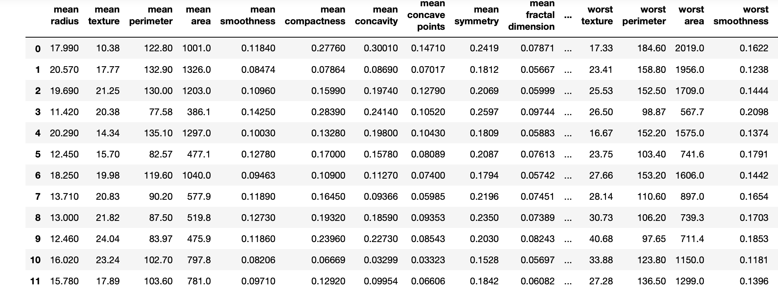
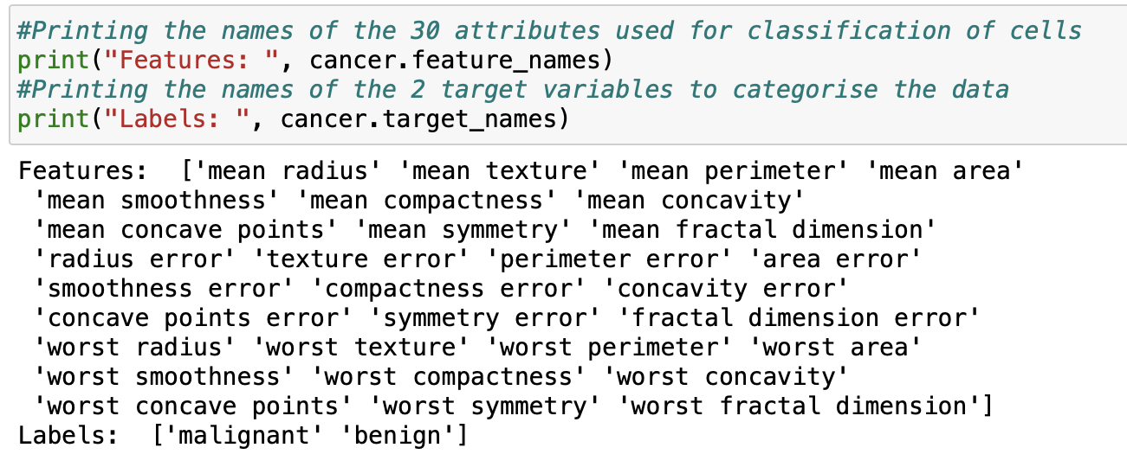
DATA FOR STUDY PREDICTIVE MODELLING FOR BREAST CANCER
SCREENSHOT OF DATAFRAME
Data for this study has been sourced through a popular Scikit learn dataset which was based on a Medical Study conducted by the University of Wisconsin, Clinical Sciences Center.
This data set contains a total of 30 attributes which include different factors affecting the status of a cell.
The study used 569 values for the creation of the classification model.
LIST OF ATTRIBUTES AND TARGET VALUES

Slide 5
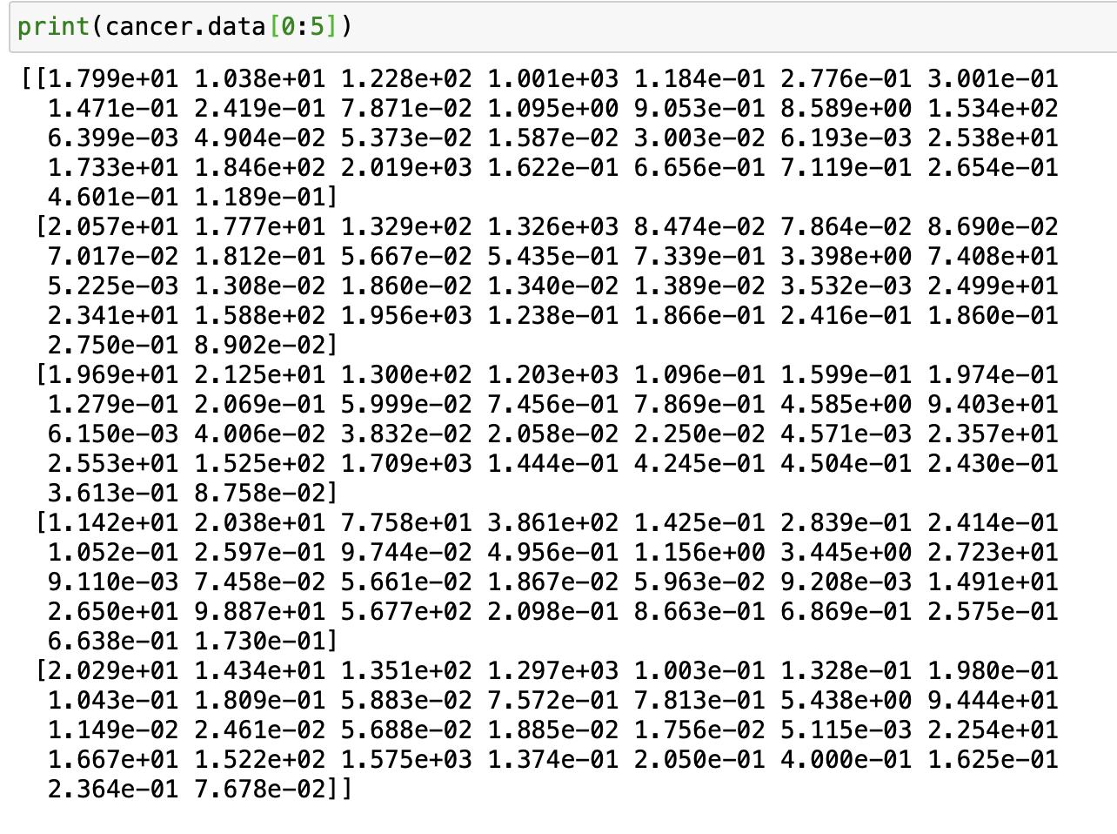
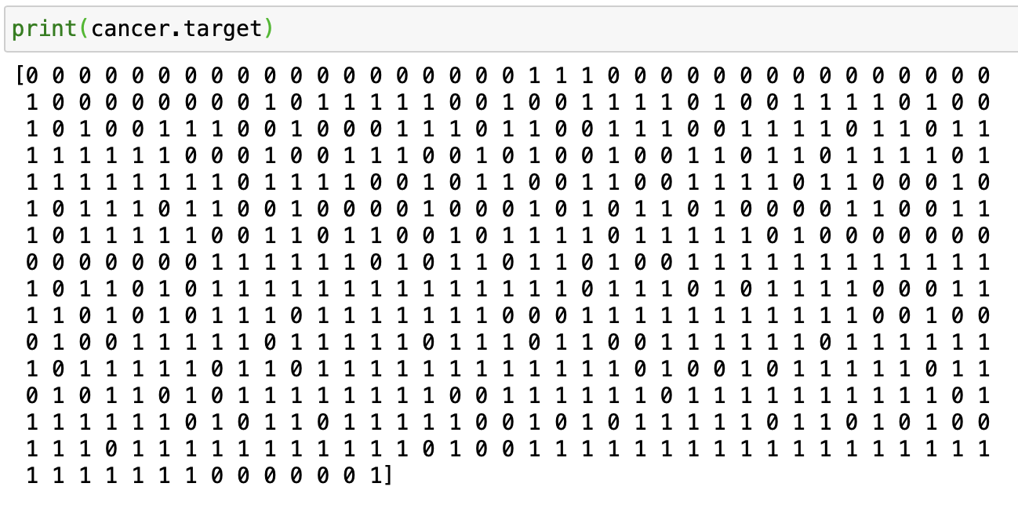
DATA FOR STUDY PREDICTIVE MODELLING FOR BREAST CANCER
VALUES OF ATTRIBUTES
Data for this study has been sourced through a popular Scikit learn dataset which was based on a Medical Study conducted by the Wisconsin Cancer Study Foundation.
This data set contains a total of 30 attributes which include different factors affecting the status of a cell.
The study used 569 values for the creation of the classification model.
VALUES IN TARGET VARIABLE

Slide 6
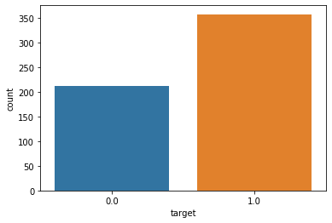
Checking for bias in DATA FOR STUDY PREDICTIVE MODELLING FOR BREAST CANCER
It is also important for us to ensure that the dataset being used for modelling of is representative and not overly biased. Therefore, this visualization seeks to depict whether both values are present in the model.
We find,
0.0 representing Benign Cells has 212 entries;
1.0 representing the Malignant Cells has 357 entries.

Slide 7
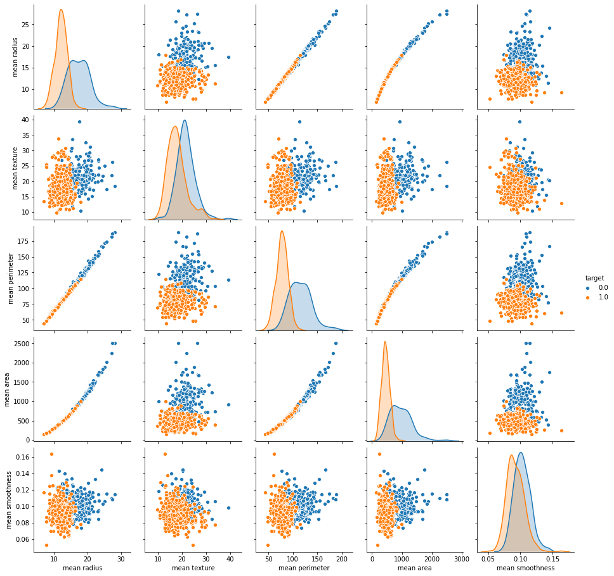
DATA VISUALISATION PREDICTIVE MODELLING FOR BREAST CANCER
Data for this study has been visualized here through scatter plots and area plots to indicate the relationship of the Features of the cells to the Target variables represented in the data as 0.0 : benign cells and
1.0 : malignant cells.

Slide 8
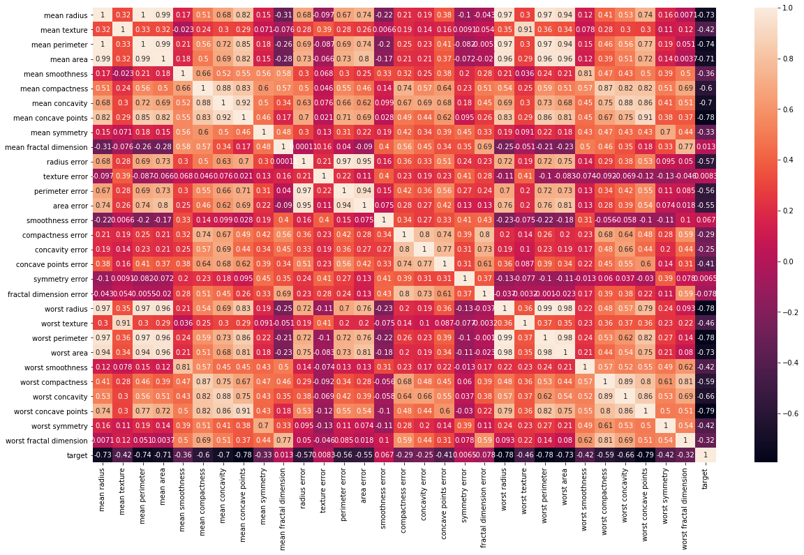
DATA VISUALISATION PREDICTIVE MODELLING FOR BREAST CANCER
Data for this study has also been visualized here through a heat map where we can find a grid of all features of the cell and the correlation amongst them.
However, most important consideration for us to note in the classification of target variable is the last column where the correlation of each feature on the outcome of cell status is depicted.

Slide 9
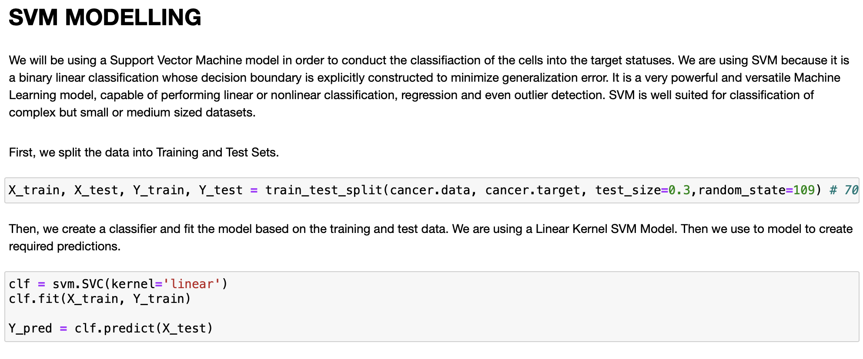
MODELLING PREDICTIVE MODELLING FOR BREAST CANCER
Advantages of Support Vector Machine Modelling
SVM works relatively well when there is a clear margin of separation between classes.
SVM is more effective in high dimensional spaces.
SVM is effective in cases where the number of dimensions is greater than the number of samples.
SVM is relatively memory efficient.
The data-set suited our requirements, hence our choice was an SVM model.
CREATING AN SVM MODEL IN JUPYTER
Disadvantages of Support Vector Machine Modelling
SVM algorithm is not suitable for large data sets.
SVM does not perform very well when the data set has more noise i.e. target classes are overlapping.
In cases where the number of features for each data point exceeds the number of training data samples, the SVM will underperform.
As the support vector classifier works by putting data points, above and below the classifying hyperplane there is no probabilistic explanation for the classification.

Slide 10
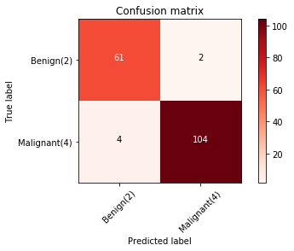
PROBLEM DESCRIPTION: Model evaluation PREDICTIVE MODELLING FOR BREAST CANCER
The Confusion matrix gives us a Visual representation of the True and Predicted Labels. This depicts a high level of accuracy for our model.
The Accuracy score for the model is 96.49%
The Precision Score for the model is 98.11%
The Recall Score for the model is 96.29%
The F-Score for the model is 96.5%
The Jaccard Score for the model is 94.54%
**THESE EVALUATION ARE PROMISING AND CONVEY A HIGH LEVEL OF ACCURACY FOR OUR MODEL.

Slide 11
CONCLUSION PREDICTIVE MODELLING FOR BREAST CANCER
This marks the end of the Journey at IBM DATA Science Professional Specialization for whose last Capstone Project, this presentation has been prepared.
This Capstone included detailed Data Refining, Cleaning, Visualization, Analysis and Modelling of data.
This real-life application of Data Science has allowed us to be able to classify the Breast cancer cells based on features.

